Slide 1
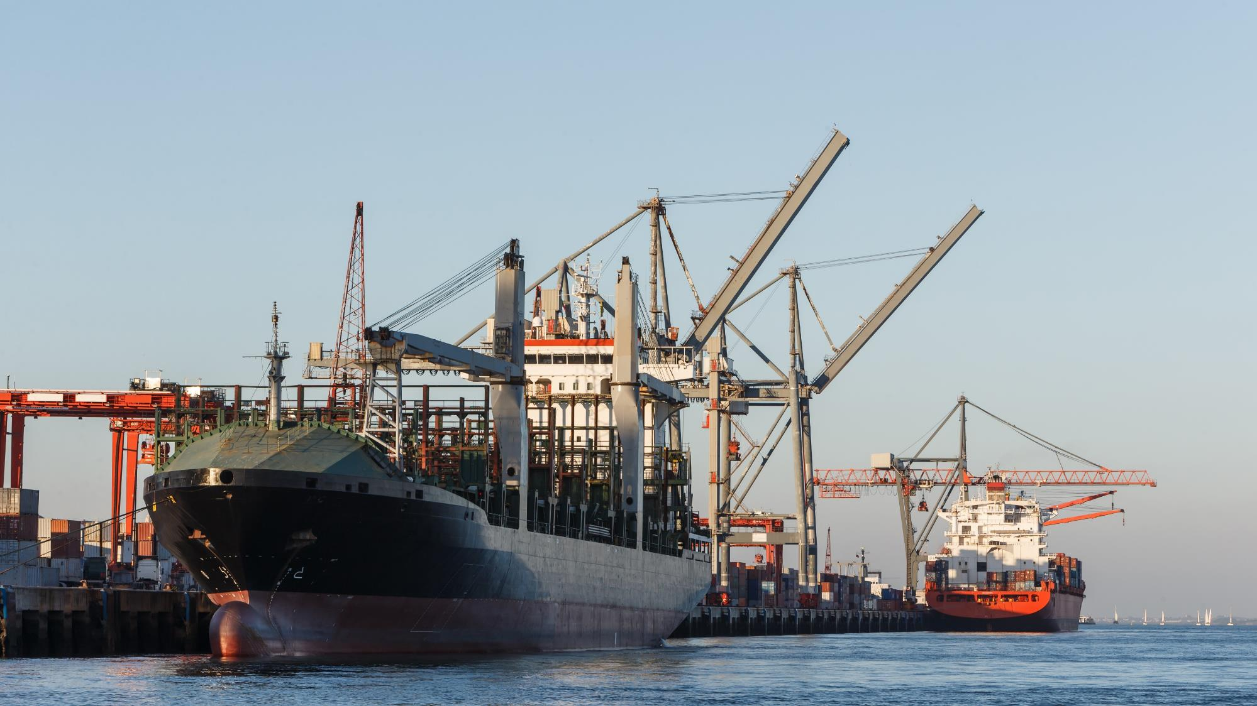


THE INDEPENDENT VOICE OF TRUST
Metals and Minerals Field Inspection Safety Code
Webinar – April 26th 2023
Presented by:
Paulo Balagueiras, Bureau Veritas
Chris Ranschaert, SGS

Slide 2



Safety Code
Speakers
Chris Ranschaert
Global Technical Governance – Quality & Audit
SGS
Paulo Balagueiras
Group QHSE Vice President
Bureau Veritas

Slide 3

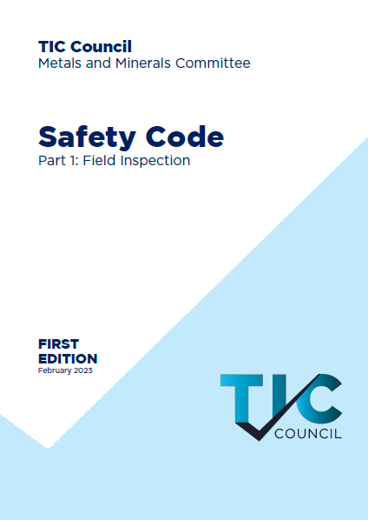
TIC Council
Safety Code
Part 1:
Field Inspection

Slide 4

Safety Code
There are many Safety guidelines contained within the inspection standards or the factories, silo’s, warehouses, port area’s… we operate in, all essentially have the same goal: Everyone goes home safely every day’.
History
In July 2019, a safety code was published by the Petcom, including minimum requirements on some specific topics. The Metals and Minerals Committee decided to develop one for their own purposes!

Slide 5
Safety Code
History
This document sets out the expectations which TIC Council Member Companies should meet with regards to safety conduct and also the responsibilities which other parties are expected to fulfil in order to ensure that inspection work continues to be carried out in a safe manner.
The TIC Council’s Safety Code was published in February 2023

Slide 6
Safety Code
Responsibilities
Key Safety Issues
  Personal Protective Equipment (PPE)
  Driving and Journey Planning
  Risk Assessments and Hazard Awareness
  Intervention and Stop Work Authority (SWA)
  Slips, Trips and Falls
  Lifting and Carrying
  Vessel Access (On and Offshore)
  Flammability
  Substances hazardous to health
  Confined Space Entry
  Working at Height / Road trucks and Rail Freight Trains
  Human Factors
  Heat and Cold Exposure
  Engulfment / Sampling Stockpiles
  Sampling around Conveyor Belts / Rolling and Moving Equipment
  Working around Railcars
Conclusion
Content

Slide 7
Safety Code
Responsibilities
Defines the responsibilities of the TIC member company, facilities, vessel owners, ports including:
Personnel is trained, equipped and competent
Safety induction training within facilities
Unaccompanied working on vessels and facilities
Risks when working onboard ship (confined spaces, sampling, draft survey…)
Providing a safe working environment including access
Key meeting topics to be discussed prior to any operation
Managing shift changes and having sufficient hand over time

Slide 8

Safety Code
Personal Protective Equipment (PPE)
  Mandatory standard PPE specified
  Additional PPE defined by client or risk assessment
  Use of SCBA only under Permit To Work criteria
Topics
Driving and Journey Planning
  Seat Belts mandatory for all vehicle occupants
  Use of mobile phones minimized even within legislation
  Journey planning in place to include regular breaks
  Vehicle road worthiness and license checks
  Hazardous goods in vehicles (DOT Boxes etc.)

Slide 9

Safety Code
Risk Assessments and Hazard Awareness
  Formal Risk Assessments (FRA) – Documented risk assessments in place for all routine activities, produced by trained and competent assessors
  Dynamic Risk Assessment (DRA) – Not typically documented but a continuous review process carried out by the individual throughout their work activity.
Topics
Intervention and Stop Work Authority (SWA)
  “The right and responsibility to stop any operation, which has imminent hazard to safety, health, equipment, and/or the environment.”
  Reasons for using the SWA outlined.
  Reporting and escalation process when an SWA is used.

Slide 10
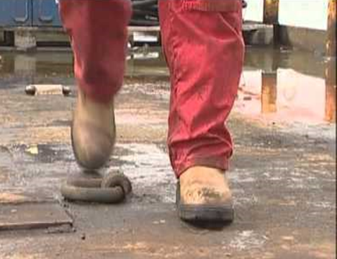
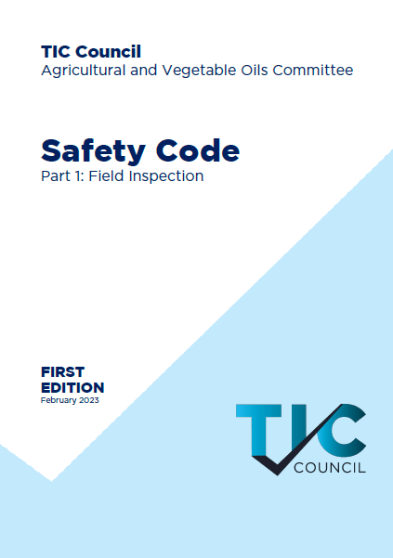
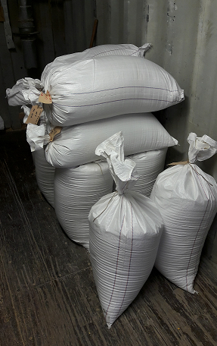
Safety Code
Slips, Trips and Falls
  Contributing factors contributing to STF’s
  How to reduce the risks including footwear
  Specific topic of ships/barges due to increased risk
  Includes to specific hazards on the deck
Topics
Lifting and Carrying
  More than a third of all workplace accidents reported are related to lifting and carrying loads.
  The maximum weight of samples to be carried by an inspector at any given point should not exceed 20 kilos
  Reducing unnecessary samples will assist in reducing the weight
  Addition time required or additional resources

Slide 11

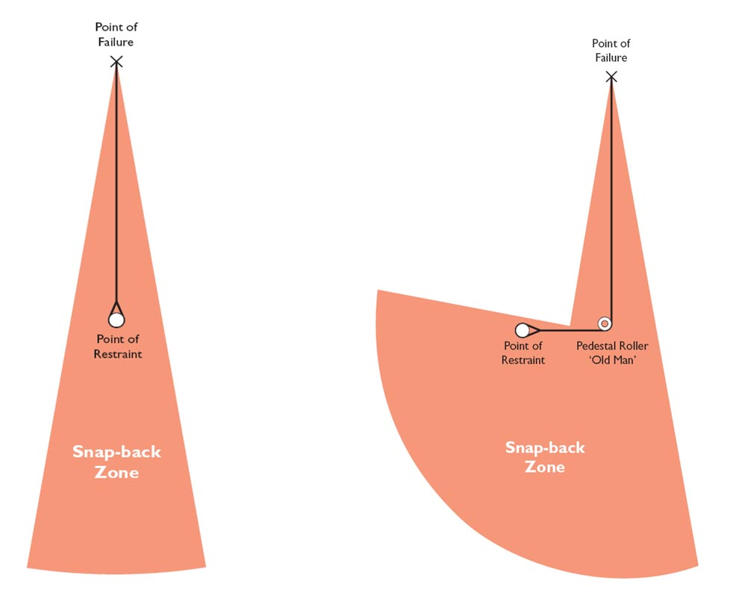
Safety Code
Topics
Flammability
  Upper and Lower explosive levels
  Inspection equipment being used in the field
  Potential ignition sources and safe use of equipment
  Dust Explosions / Spontaneous combustion
Vessel Access
  Covers all topics of vessel access
  Gangways, (Pilot) Ladders, Launches, Helicopters
  Additional PPE requirements and Training
  Bights and Snap-Back zones

Slide 12
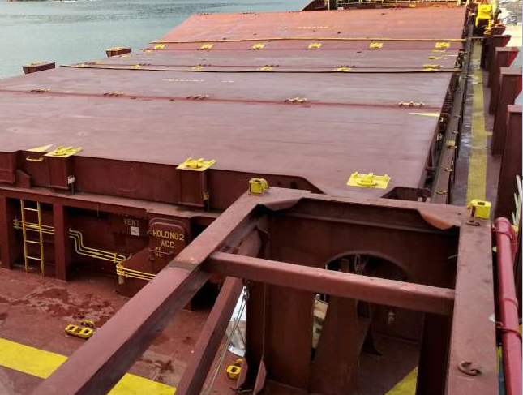
Safety Code
Substances hazardous to health
  Use of Safety Data Sheets
  Minimizing risk of exposure
  Dust and silicate materials
  Oxygen and CO
Topics
Confined Space Entry
  Permit to Work procedures
  Checklist as an Annex to assist with the PTW
  Responsibilities for checking the atmosphere and ongoing processes

Slide 13
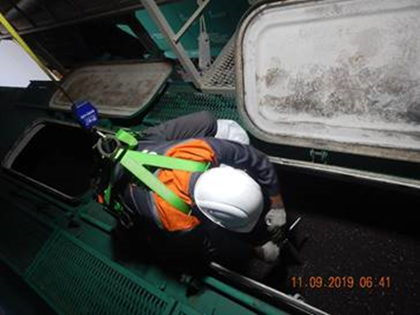
Safety Code
Working at Height / Road trucks and Rail freight trains
  Defining what working at height means
  Precautions to be implemented to reduce risk of fall
  Specific issues with Rail and Road tankers
  Risk assessments for all non routine activities
Topics
Human Factors
  Physical and mental ability of the field inspectors
  Fatigue management and work/rest hour balance
  Drug and alcohol policies
  Supportive health and safety culture

Slide 14
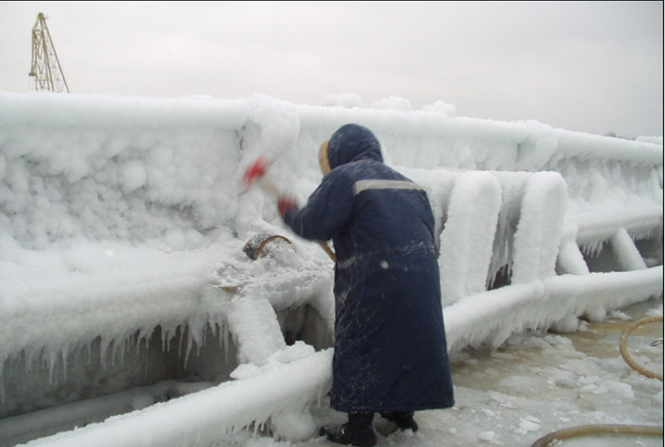

Safety Code
Heat and Cold exposure
  Working in extreme environments
  Cold environments
  Hot environments
  TIC Council Members Companies should consider the risk of exposure to such conditions
Topics
Engulfment / Sampling Stockpiles
  Stockpile collapse / Caving in
  Angle of repose
  Vertical grain wall avalanche
  Grains vacuums

Slide 15
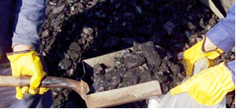
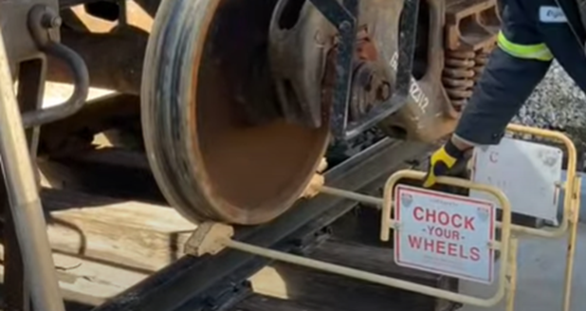
Safety Code
Working around conveyor belts / Rolling and moving equipment
    Verifying that no other sampling point can be agreed
    Asking the stevedore/silo owners to install a safety cage
    Making sure there is a safety “rope”
Topics
Working around Railcars
  Before entry to the railyard
  Track- and railcar securement
  Working in the railyard and around railcars

Slide 16
Safety Code
This Code has been prepared by TIC Council Member Companies with support from a number of client companies aimed at reducing the risks involved in independent inspection activities.
It is an expectation that TIC Council Member Companies and their clients together with inspection facilities, ports and vessel owners will follow the spirit of this code.
The Code is a living document and will be reviewed on a regular basis as safety techniques, technology and the requirements of the work continue to develop.
Conclusions

Slide 17
Safety Code
External feedback on the Safety Code is welcomed and should be directed to secretariat@tic-council.org
Any other topics?
The Safety Code is available as a free download from the TIC Website:
https://www.tic-council.org/publications/codes-and-guidelines
Next Steps

Slide 18

QUESTIONS?

Slide 19




Follow us online
@TICCouncil
TIC Council
Wikipedia page:
Testing, inspection and certification
TIC-Council.org

