Slide 1
THE INDEPENDENT VOICE OF TRUST
Agricultural and Vegetable Field Inspection Safety Code
Webinar – April 25th 2023
Presented by:
Kristina Grinishena, Bureau Veritas
Chris Ranschaert, SGS

Slide 2
Safety Code
Chris Ranschaert
Global Technical Governance – Quality & Audit
SGS
Kristina Grinishena
Global Key Account Manager Commodities Global Service Line
Bureau Veritas

Slide 3
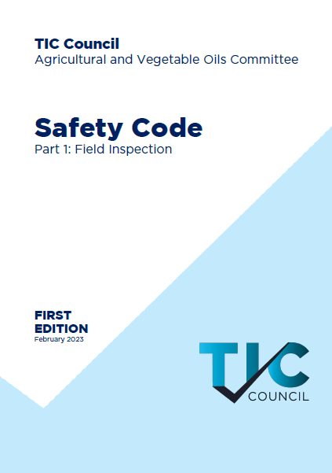
TIC Council
Safety Code
Part 1:
Field Inspection

Slide 4
Safety Code
There are many Safety guidelines contained within the inspection standards or the factories, silo’s, warehouses, port area’s… we operate in, all essentially have the same goal: Everyone goes home safely every day’.
History
“In the event that the facility is unsafe, …, the superintendents may stop the operation in order to draw increment samples as required by these Rules”

Slide 5
Safety Code
History
In July 2019, a safety code was published by the Petcom, including minimum requirements on some specific topics. The Agricultural and Vegetable Oils Committee decided to develop one for their own purposes!
This document sets out the expectations which TIC Council Member Companies should meet with regards to safety conduct and also the responsibilities which other parties are expected to fulfil in order to ensure that inspection work continues to be carried out in a safe manner.
The TIC Council’s Safety Code was published in February 2023

Slide 6
Safety Code
Responsibilities
Key Safety Issues
Personal Protective Equipment (PPE)
Driving and Journey Planning
Risk Assessments and Hazard Awareness
Intervention and Stop Work Authority (SWA)
Slips, Trips and Falls
Lifting and Carrying
Vessel Access (On and Offshore)
Flammability
Substances hazardous to health
Confined Space Entry
Working at Height / Road trucks and Rail Freight Trains
Human Factors
Heat and Cold Exposure
Engulfment / Sampling Stockpiles
Sampling around Conveyor Belts / Rolling and Moving Equipment
Working around Railcars
Conclusion
Content

Slide 7
Safety Code
Responsibilities
Defines the responsibilities of the TIC member company, facilities, vessel owners, ports including:
Personnel is trained, equipped and competent
Safety induction training within facilities
Unaccompanied working on vessels and facilities
Risks when working onboard ship (confined spaces, sampling, draft survey…)
Providing a safe working environment including access
Key meeting topics to be discussed prior to any operation
Managing shift changes and having sufficient hand over time

Slide 8
Safety Code
Personal Protective Equipment (PPE)
Mandatory standard PPE specified
Additional PPE defined by client or risk assessment
Use of SCBA only under Permit To Work criteria
Topics
Driving and Journey Planning
Seat Belts mandatory for all vehicle occupants
Use of mobile phones minimized even within legislation
Journey planning in place to include regular breaks
Vehicle road worthiness and license checks
Hazardous goods in vehicles (DOT Boxes etc.)

Slide 9
Safety Code
Risk Assessments and Hazard Awareness
Formal Risk Assessments (FRA) – Documented risk assessments in place for all routine activities, produced by trained and competent assessors
Dynamic Risk Assessment (DRA) – Not typically documented but a continuous review process carried out by the individual throughout their work activity.
Topics
Intervention and Stop Work Authority (SWA)
“The right and responsibility to stop any operation, which has imminent hazard to safety, health, equipment, and/or the environment.”
Reasons for using the SWA outlined.
Reporting and escalation process when an SWA is used.

Slide 10
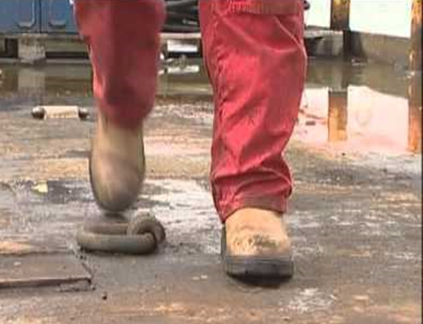
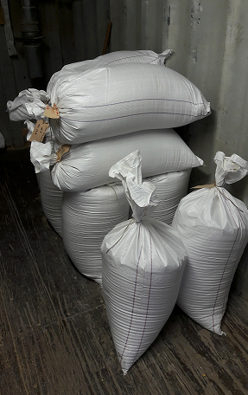
Safety Code
Slips, Trips and Falls
Contributing factors contributing to STF’s
How to reduce the risks including footwear
Specific topic of ships/barges due to increased risk
Includes to specific hazards on the deck
Topics
Lifting and Carrying
More than a third of all workplace accidents reported are related to lifting and carrying loads.
The maximum weight of samples to be carried by an inspector at any given point should not exceed 20 kilos
Reducing unnecessary samples will assist in reducing the weight
Addition time required or additional resources

Slide 11
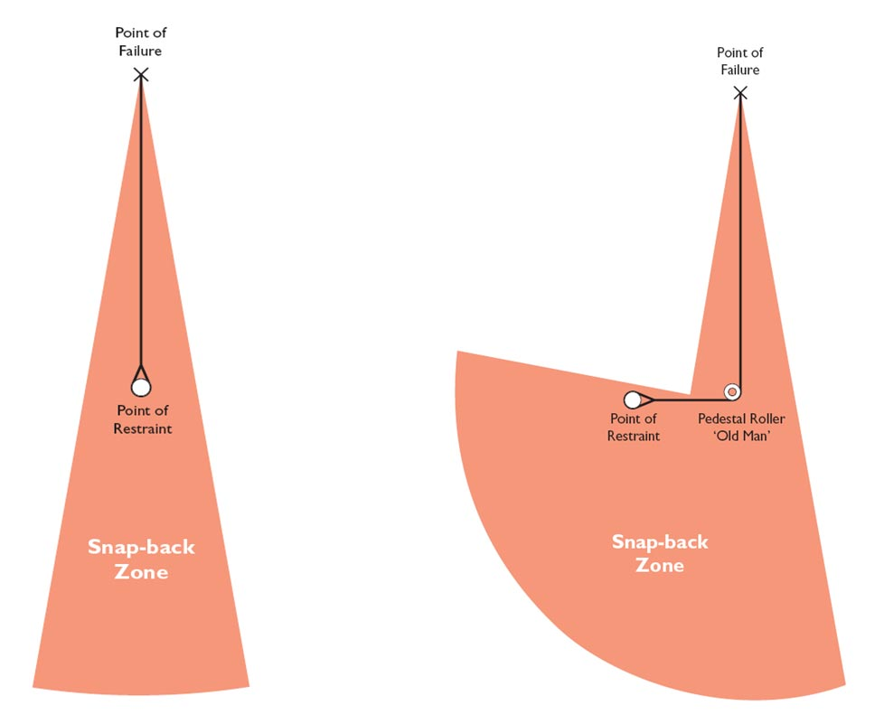
Safety Code
Topics
Flammability
Upper and Lower explosive levels
Inspection equipment being used in the field
Potential ignition sources and safe use of equipment
Dust Explosions / Spontaneous combustion
Vessel Access
Covers all topics of vessel access
Gangways, (Pilot) Ladders, Launches, Helicopters
Additional PPE requirements and Training
Bights and Snap-Back zones

Slide 12
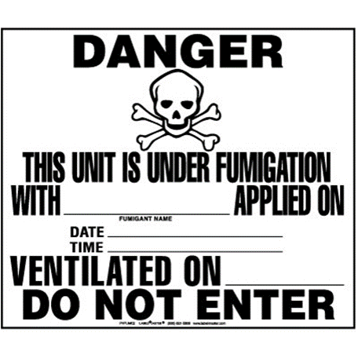
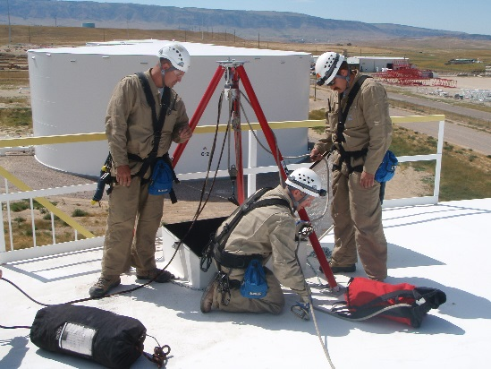
Safety Code
Substances hazardous to health
Use of Safety Data Sheets
Minimizing risk of exposure
Dust
Oxygen and CO
Phosphine, Fumigation
Mycotoxins
Topics
Confined Space Entry
Permit to Work procedures
Checklist as an Annex to assist with the PTW
Responsibilities for checking the atmosphere and ongoing processes

Slide 13
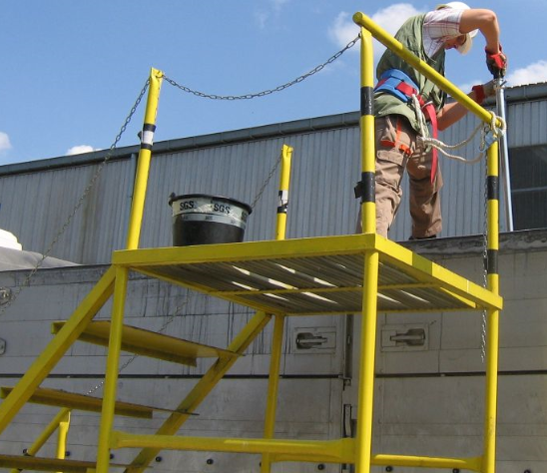
Safety Code
Working at Height / Road trucks and Rail freight trains
Defining what working at height means
Precautions to be implemented to reduce risk of fall
Specific issues with Rail and Road tankers
Risk assessments for all non routine activities
Topics
Human Factors
Physical and mental ability of the field inspectors
Fatigue management and work/rest hour balance
Drug and alcohol policies
Supportive health and safety culture

Slide 14
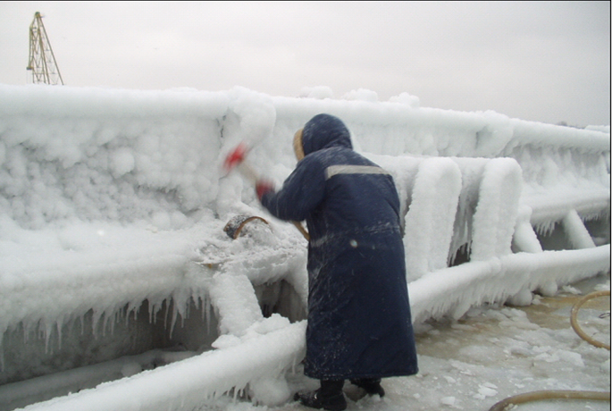
Safety Code
Heat and Cold exposure
Working in extreme environments
Cold environments
Hot environments
TIC Council Members Companies should consider the risk of exposure to such conditions
Topics
Engulfment / Sampling Stockpiles
Stockpile collapse / Caving in
Angle of repose
Vertical grain wall avalanche
Grains vacuums

Slide 15
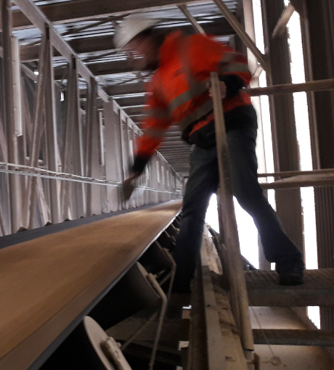
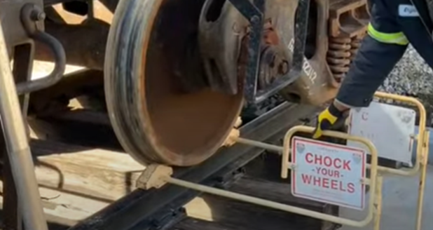
Safety Code
Working around conveyor belts / Rolling and moving equipment
Verifying that no other sampling point can be agreed
Asking the stevedore/silo owners to install a safety cage
Making sure there is a safety “rope”
Topics
Working around Railcars
Before entry to the railyard
Track- and railcar securement
Working in the railyard and around railcars

Slide 16
Safety Code
This Code has been prepared by TIC Council Member Companies with support from several client companies aimed at reducing the risks involved in independent inspection activities.
It is an expectation that TIC Council Member Companies and their clients together with inspection facilities, ports and vessel owners will follow the spirit of this code.
The Code is a living document and will be reviewed on a regular basis as safety techniques, technology and the requirements of the work continue to develop.
Conclusions

Slide 17
Safety Code
External feedback on the Safety Code is welcomed and should be directed to secretariat@tic-council.org
Any other topics?
The Safety Code is available as a free download from the TIC Website:
https://www.tic-council.org/publications/codes-and-guidelines
Next Steps

Slide 18
QUESTIONS?

Slide 19
Follow us online
@TICCouncil
TIC Council
Wikipedia page:
Testing, inspection and certification
TIC-Council.org

