Slide 1
15 March 2023
Market Study Report
Consumer Goods in the EU: Persisting Safety Issues

Slide 2
Market Study
Between 2012 and 2017, TIC Council carried out market studies, including tests of self-assessed electrical consumer goods to assess the compliance of consumer electrical products sold in the European Single Market with basic safety requirements from European product safety legislation.
The project’s objective was:
to assess the enforcement of EU product legislation and the degree of safety that consumers can expect from the EU Single Market;
to deliver insights into the impact that different approaches to conformity assessment can have on compliance outcomes, and, thus, consumer product safety.
In 2022, TIC Council decided to reiterate the tests to check whether, after 10 years, the consumer safety situation in the EU had improved.

Slide 3
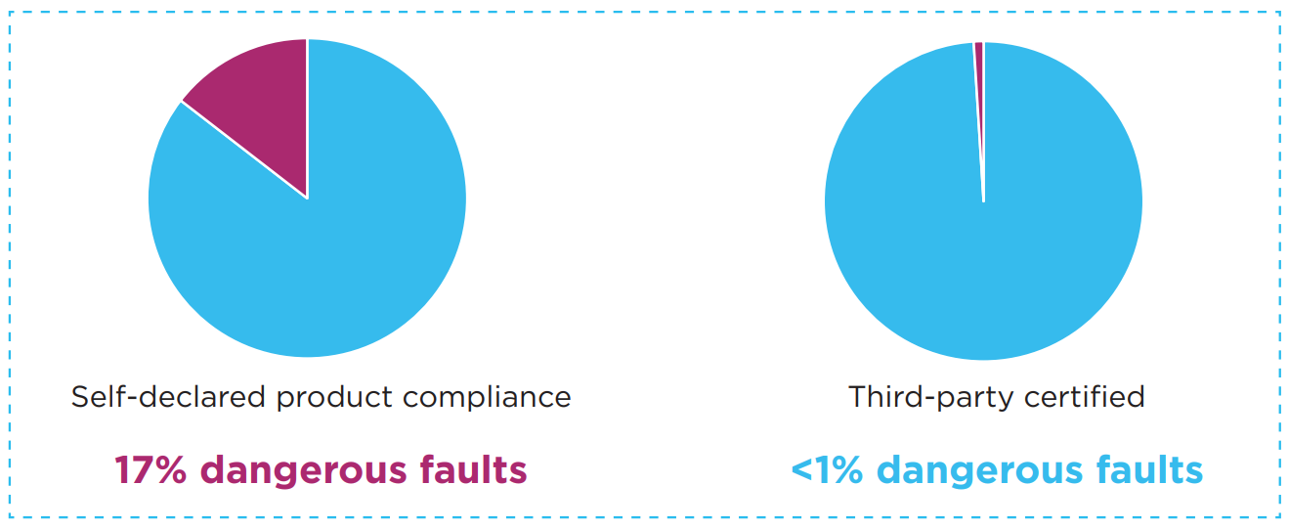
Background
From 2012 to 2017 IFIA and CEOC carried out a series of market studies, acquiring samples from various international markets, and retested them in independent accredited laboratories to verify their compliance with the applicable safety regulations.
Figure 1 shows that of all products tested, 17% of the self-declared products showed dangerous faults, compared to less than 1% dangerous faults for products that were third-party certified.
The results indicated that products that were neither inspected nor tested by TIC bodies were grossly non-compliant. Over 70% of the products tested showed non-conformities, and 17% showed dangerous non-conformity, i.e., faults likely to cause bodily damage to consumers, fires, or property loss.

Slide 4
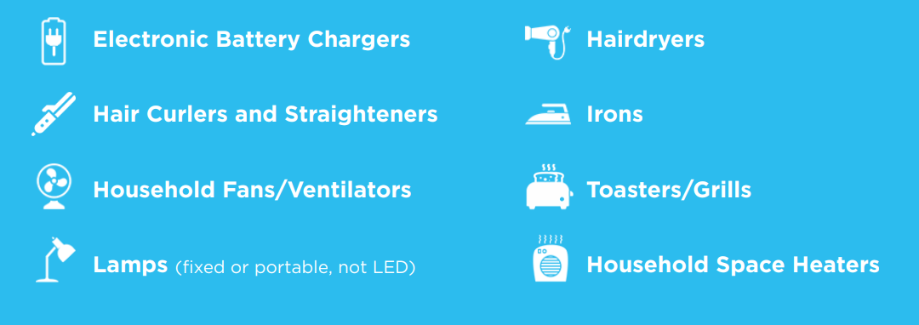
Methodology
The consumer electrical products were selected amongst those with the most significant market distribution, the broader potential of causing serious harm to users and for which there are established safety standards. These products include:
120 samples were sourced from 7 different EU countries, including:
Finland
Sweden
Germany
France
Samples were selected at random off the shelves of national retailers, containing a mix of both known brands and no-name brands;
All selected products were self-declared.
Poland
Spain
Italy

Slide 5
RESULTS
Of the 120 products tested, 85 were not compliant with the standards, and 28 presented dangerous non-complying results with safety requirements.
What changed from 2012 to today?
increase of 15 percentage points in the total number of non-conformities
6 percentage points increase in dangerous non-conformities, from 17% to 23%.

Slide 6
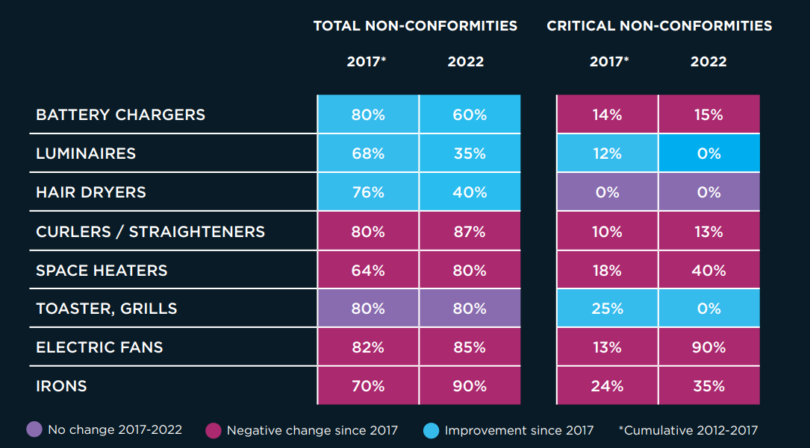
Comparative table, 2022 percentages vs 2012-2017

Slide 7
Follow us online
@TICCouncil
www.tic-council.org

Slide 8
Product compliance and market surveillance in the European Union
TIC Council - 15 March 2023
Kristyna Deiberova
Unit E4 “Product Safety & Rapid Alert System”
DG Justice and Consumers

Slide 9
Safety Gate:
the EU rapid alert system for dangerous non-food products
Safety Gate: the EU rapid alert system for dangerous non-food products (europa.eu)

Slide 10
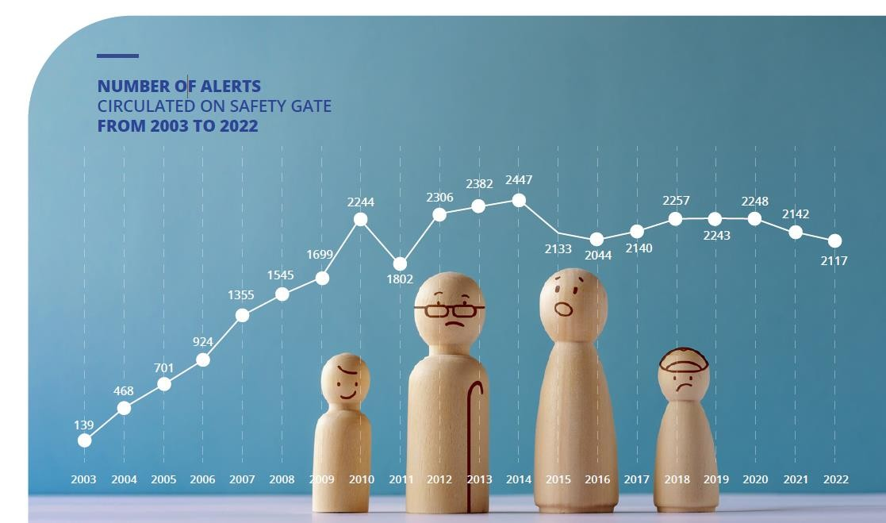
Exchanging information about
dangerous products since 2003
The exchange of information about non-food dangerous products kicked off informally in 2001 and became
compulsory after the adoption of the General Product Safety Directive, which set up the Rapid Alert System for non-food dangerous products, currently called Safety Gate.
The number of alerts exchanged progressed in the first 8 years and stabilized at the level of above 2000 alerts exchanged per year since 2012.

Slide 11
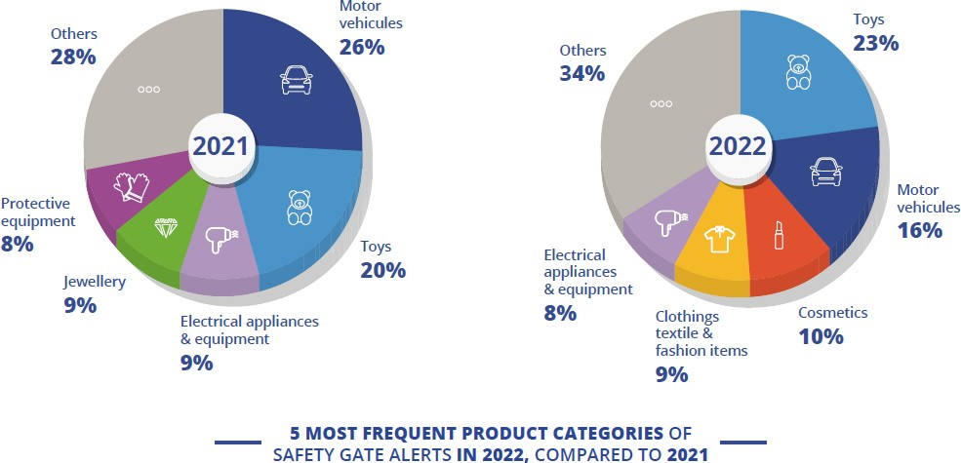
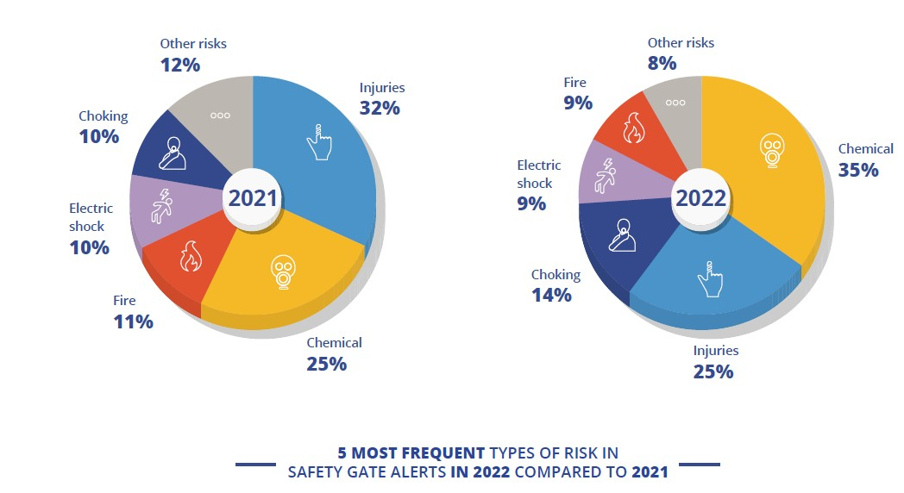
2021-2022: the system very active in spite of economic and political pressure
These last two years have brought many changes and challenges to the system. End of 2020, the system lost one member, the United Kingdom. However, the number and quality of alerts exchanged did not alter much. National authorities continued their work. During the COVID-19 pandemic they monitored products related to it, such as facial masks and gloves. In 2022, in spite of the economic instability, their action went on.
In 2022, most of the alerts detected chemical risk on cosmetics, toys and shoes for example.

Slide 12
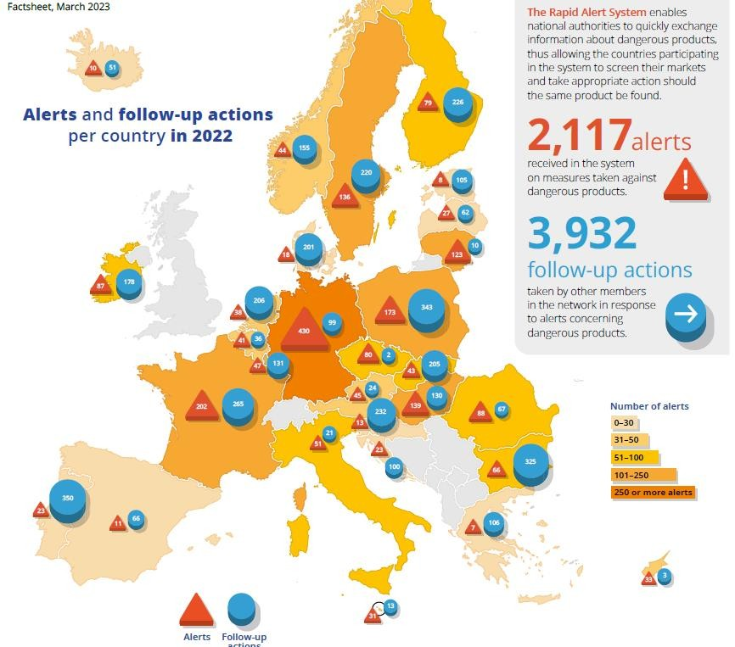
Lets Take A Break 10 Min

Slide 13
Upcoming Regulation of the European Parliament and of the Council on general product safety (GPSR)
EU safety net

Slide 14
GPSR objectives
Update and modernise the general framework for safety of non-food consumer products to preserve its role as a safety net for consumers and ensure level-playing field for businesses
Closes gaps by:
Covering safety of all non-harmonised products
Covering all types of safety risks, including risks of harmonised products not
covered by EU harmonisation legislation
Improving enforcement by aligning the market surveillance regime
Setting the minimum safety obligations for all economic operators and all types of sales
Introducing product safety requirements for online marketplaces
Addressing effectiveness of product recalls

Slide 15
Adoption
(vote in Plenary session in the EP followed by approval by the Council)
30 June 2021
Commission proposal
Entry into application 18 months after entry into force
28 November
2022
Political agreement
Publication in the OJEU

Slide 16
New
technologies
Online
sales
Obligations of economic operators
Main novelties of the GPSR
Product
recalls
Market surveillance
Change of legal instrument
Traceability

Slide 17
Main novelties of the GPSR (1)
Addressing safety of products linked to new technologies
Coverage of new risks posed by new technologies to consumer’s health and safety and personal security risks →risks part of the risk assessment
Clarify software related rules (definition of product, risk assessment)
Substantial modification
Addressing challenges posed to product safety by the growth of online sales, including via
online marketplaces
Product safety obligations of online marketplaces:
Obligation to register in the Safety Gate and to follow up on orders and notices
Design of the interface to ensure display of traceability and safety information
Cooperation obligations
Ex post random checks
Close interlink and coherence with the Digital Services Act
Aligning requirements for online and offline sales
Display same information online as it is with the product offline

Slide 18
Main novelties of the GPSR (2)
Ensuring a better enforcement of the product safety rules and more efficient and even market surveillance
Alignment with market surveillance and traceability rules applicable to harmonised products
Clear obligations for economic operators
Responsible economic operator in the EU for all non-harmonised products and additional tasks
Possibility to set further requirements for traceability systems through delegated acts
Possibility for COM to issue an opinion to solve divergences in risk assessment
Systematic use of the Safety Business Gateway, including for accident reporting
Align standardisation procedures to the general regime contained in Regulation (EU) 1025/2012

Slide 19
Main novelties of the GPSR (3)
Making product recalls more effective
Mandatory requirements on product recalls:
to raise consumer awareness:
direct notification of consumers
wide dissemination of information, including publication of notices by online marketplaces
use of registration schemes
to increase consumer reaction to recalls:
key elements for recall notices with possible mandatory template
right to remedy
Integrating food-imitating products safety assessment
Repeal the Food-imitating product Directive and introduce aspects related to food imitating products in the safety
assessment under GPSD
Extension to child-appealing products
Change of the legal instrument into Regulation
Ensure even application via Regulation

Slide 20
Thank you
Contact: Kristyna.Deiberova@ec.europa.eu
Consumer product safety | European Commission (europa.eu)
https://ec.europa.eu/info/business-economy-euro/product-safety-and-requirements/product-safety/consumer-product-safety_en#the-revision-of-the- general-product-safety-directive
=> Commission’s proposal, background information, underlying studies, impact assessment
Provisional political agreement on the GPSR:
https://data.consilium.europa.eu/doc/document/ST-16312-2022-INIT/en/pdf https://www.europarl.europa.eu/meetdocs/2014_2019/plmrep/COMMITTEES/IMCO/AG/2023/01-23/1269862EN.pdf
© European Union 2020
Unless otherwise noted the reuse of this presentation is authorised under the CC BY 4.0 license. For any use or reproduction of elements that are not owned by the EU, permission may need to be sought directly from the respective right holders.

Slide 21
EuroCommerce – keeping consumers safe
TIC launch Market Study “Consumer Goods in the EU: Persisting Safety Issues.” 15 March 2023
Els Bedert, Director Product Policy and Sustainability

Slide 22
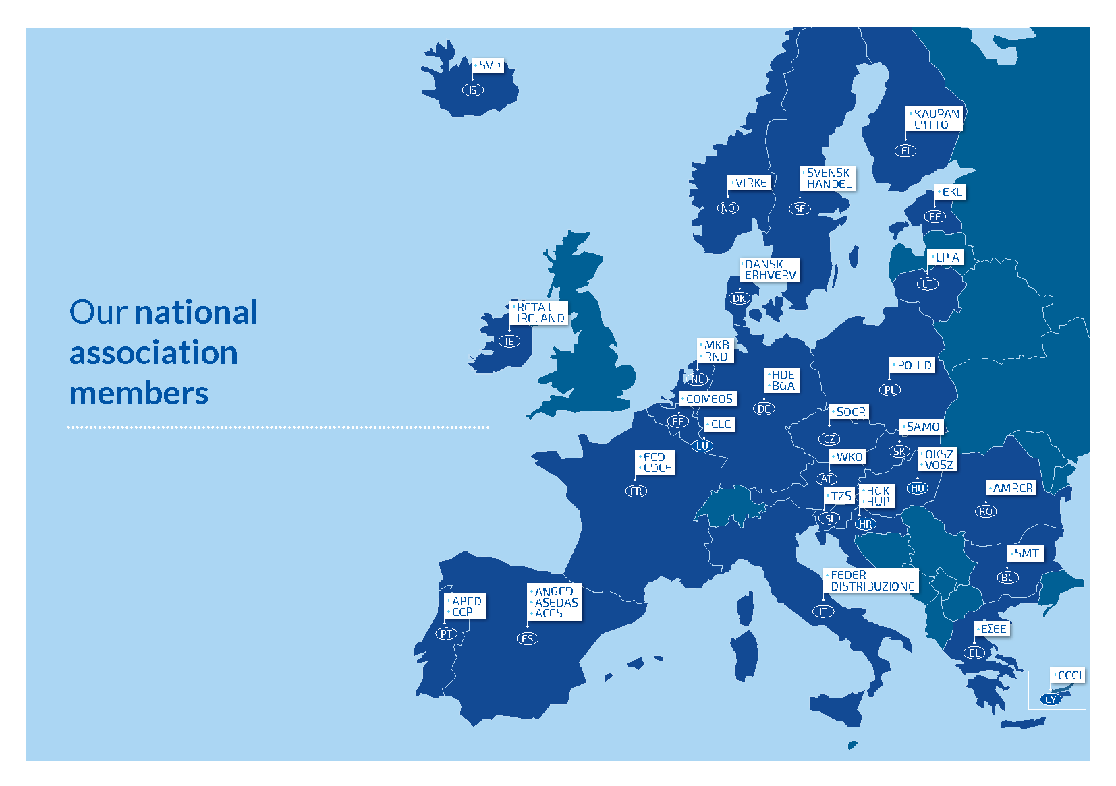
Who we are, what we do
We stand for:
Fair, competitive & sustainable retail and wholesale in Europe.
through
EU advocacy and Intelligence
Research, learnings and thought leadership
Exchange and networking
Positive communication and sector reputation
1 in 4 companies in the EU are SME retailers and wholesalers
Retail and Wholesale represents 10% of the EU’s GDP
We provide work to 26 million Europeans, so 1 in 7 of all jobs

Slide 23
Retail and wholesale provide essential services

Slide 24
Retail & wholesale in numbers

Slide 25
Our sector ….

Slide 26
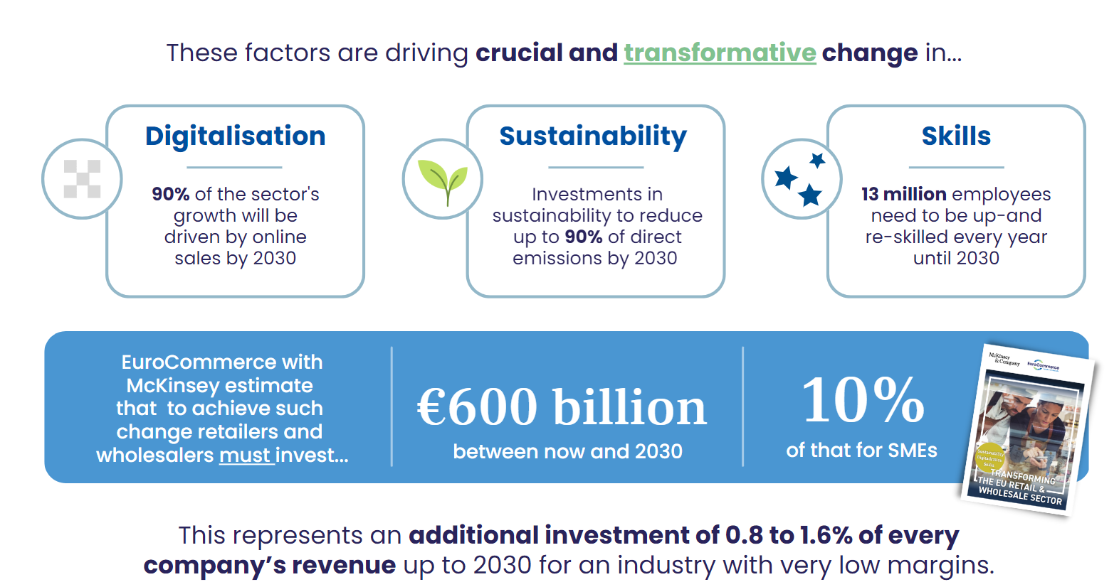
Triple transformation study – EuroCommerce & McKinsey
Notes:
Digital transformation
E-commerce - continues to grow
Automation – delivery, fleets, back office etc.
Advanced analytics - supply chain management, route optimisation, recycling, assortment, customer interaction etc. )
Sustainability transformation
Renewable energy
Recycling, waste management
Growing sustainable product offer
Skills and talent
Technical skills, consumer support, management roles

Slide 27
Consumers
Our sector serves…
An essential service for EU’s 450 million consumers to access quality, safe, innovative products & solutions by responding to consumer demand.
Close relationship with consumers: offer choice, quality & convenience (omni-channel) => advice
Nudging consumers (health, environment, ethical standards) and maintaining trust Business’ internal quality and compliance systems & processes
Suppliers:
Route to market for domestic & international manufacturers of all sizes in selling their goods (business quality and compliance systems /processes)
Trusted supplier relations, supported by assessments/audits
Notes:
230 335 and 35

Slide 28
Product safety
Our sector needs …
Effective and clear legal framework understandable and workable by all
Coherent legislation for (connected) products, market surveillance etc. (reducing confusion)
Risk-based approach to remain at the core
Roles and responsibilities of each type of operator in line with their sphere of influence and activities, as established by the EU acquis.
Further support by the competent authorities to help operators to comply (incl. guidance). Public-private cooperation – capacity building
Effective enforcement – weed out rogue traders
Well-functioning safety gate

Slide 29
Thank you!

Slide 30
15 March 2023
Market Study Report
Consumer Goods in the EU: Persisting Safety Issues

Slide 31
Q&A

